Slide 1
Prompt Engineering
Understanding and Designing Effective Prompts for AI Models
Presented By : Dhaval B. Lal
Date : 15/08/2024

Slide 2
Topic Covered
Introduction to Prompt Engineering
Types of Prompts
Designing Effective Prompts
Prompt Engineering Tools
Case Studies and Examples
Conclusion

Slide 3


Slide 4
Introduction to Prompt Engineering
The process of designing and refining inputs (prompts) for AI models to achieve desired outputs.
Prompt engineering is a process of creating a set of prompts, or questions, that are used to guide the user toward a desired outcome. It is an effective tool for designers to create user experiences that are easy to use and intuitive. This method is often used in interactive design and software development, as it allows users to easily understand how to interact with a system or product.

Slide 5
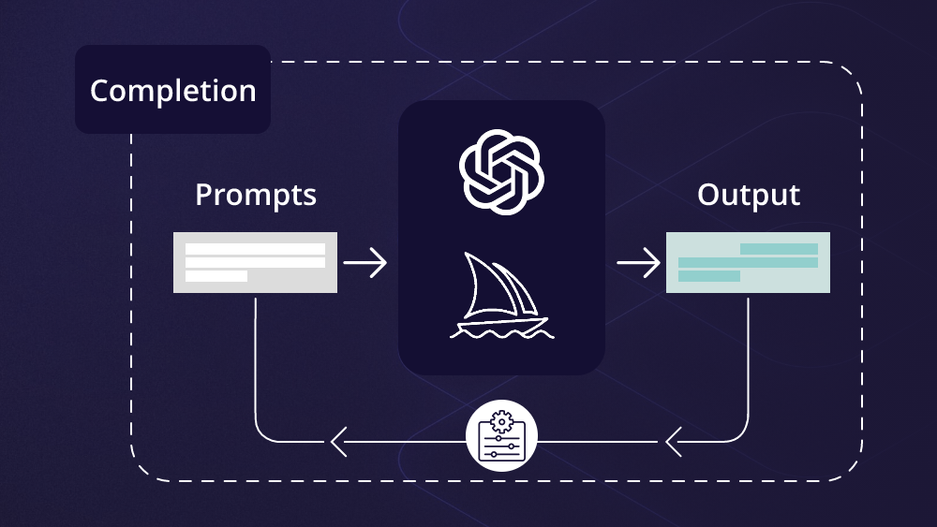

Slide 6


Slide 7
Types of Prompts
Open-ended Prompts
Encourage creativity and broader responses.
Example: “Write a story about a time traveler.“
Specific Prompts
Aim for more focused and precise answers.
Example: "List the key benefits of renewable energy.“
Instruction-based Prompts
Direct the AI to perform specific tasks.
Example: "Summarize this article in three sentences."

Slide 8
Designing Effective Prompts
Clarity and Precision
Be clear about what you want from the AI.
Avoid ambiguity to get relevant responses.
Length Considerations
Shorter prompts for direct answers.
Longer prompts for more detailed outputs.
Using Examples and Constraints
Provide examples to guide AI responses.
Set boundaries to manage the scope of the output.

Slide 9
Prompt Engineering Tools
Tools and Platforms
Various platforms offer interfaces for prompt design.
Example: OpenAI Playground, AI Dungeon.
Integration with AI Models
Connecting prompts to models like GPT, BERT, etc.
Customizing prompts for specific use cases.

Slide 10
Case Studies and Examples
Successful Prompts
Real-world examples where prompt engineering improved outcomes.
Example: Optimizing prompts for customer service chatbots.
Challenges and Lessons Learned
Examples of failed prompts and the lessons they provide.
Importance of context and audience understanding.

Slide 11
Examples
Template
Story
Detail Question on Particular subject (Science, Math's, etc..)
Suggestion about tour
About Festival
Any other Form you all

Slide 12


Slide 13
Conclusion
Recap
The significance of prompt engineering in AI.
Key strategies for effective prompt design.
Final Thoughts
The evolving landscape and future potential of prompt engineering.
Questions?
Invite the audience to ask questions.

Slide 14
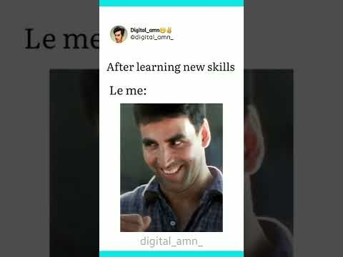

Slide 15


